Slide 1

Industrial Training Seminar
on
“Python”
Presented By:
Name :- Aryan Arya
Roll No. :- 21EJCIT017
Branch :- Information Technology
(Second Year,A1)
Submitted To:
Ms. Shikha Shrivastva
Industrial Training Coordinator
IT

Slide 2

INDEX
Introduction To Python
Features
Applications
Theory
Project
Project code
Project Glimpse

Slide 3

Introduction Of Python
Python is an interpreted, object-oriented, high-level programming language developed by Guido van Rossum. It was originally released in 1991. Designed to be easy as well as fun, the name "Python" is a nod to the British comedy group Monty Python. Python is a beginner-friendly language, replacing Java as the most widely used introductory language because it handles much of the complexity for the user, allowing beginners to focus on fully grasping programming concepts rather than minute details.

Slide 4
Features Of Python
Easy To Learn and Readable Language
Interpreted Language
Open Source And Free
Large Standard Library
High-Level Language
Object Oriented Programming Language
Graphical User Interface (GUI) Support

Slide 5
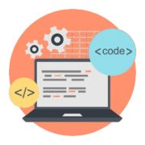


Applications of Python
Web Development
Game Development
Machine Learning
Data Visualization
Desktop GUI
Web Scraping Applications
Audio and Video Applications
Artificial Intelligence

Slide 6
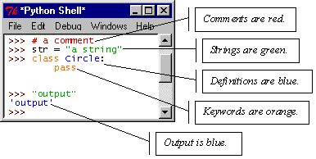
IDLE – Development Environment
IDLE helps you program in Python by:
color-coding your program code
debugging
auto-indent
interactive shell

Slide 7
Theory
OPRETOR:
1.Arithametic | +,-,*,**,/,//,%
2.Logical | and,or,not
3.Relational/Comparision | ==,<,>,<=,>=,!=
4.Assignment | =,+=,-=,*=,/=
5.Bitwise | &,|,^
6.Identity | is,is not
7.Membership | in,not in
Data Types:
Numeric ----int,float,complex
Sequence ----string, list, tuple
Dictonary ----key:value pair
Boolean
Set

Slide 8
Theory
Indentation and Blocks:
Python uses whitespace and indents to denote blocks of code
Lines of code that begin a block end in a colon:
Lines within the code block are indented at the same level
To end a code block, remove the indentation
You'll want blocks of code that run only when certain conditions are met

Slide 9
Theory
Conditional Branching :
if and else
if variable == condition: #do something based on v == c
else:
#do something based on v != c
elif allows for additional branching
if condition:
elif another condition:
…
else: #none of the above

Slide 10
Theory
Looping with For :
For allows you to loop over a block of code a set number of times
For is great for manipulating lists:
a = ['cat', 'window', 'defenestrate'] for x in a: print x, len(x)
Results:
cat 3
window 6
defenestrate 12

Slide 11
Project
Library used :-
1. tkinter(ttk,messagebox)
2. os
3. PIL(Image,ImageTk)
4. webbrowser
This project is based on GUI(Graphical User Interface),I just
created JECRC Portal on the bases Industrial Training .

Slide 12
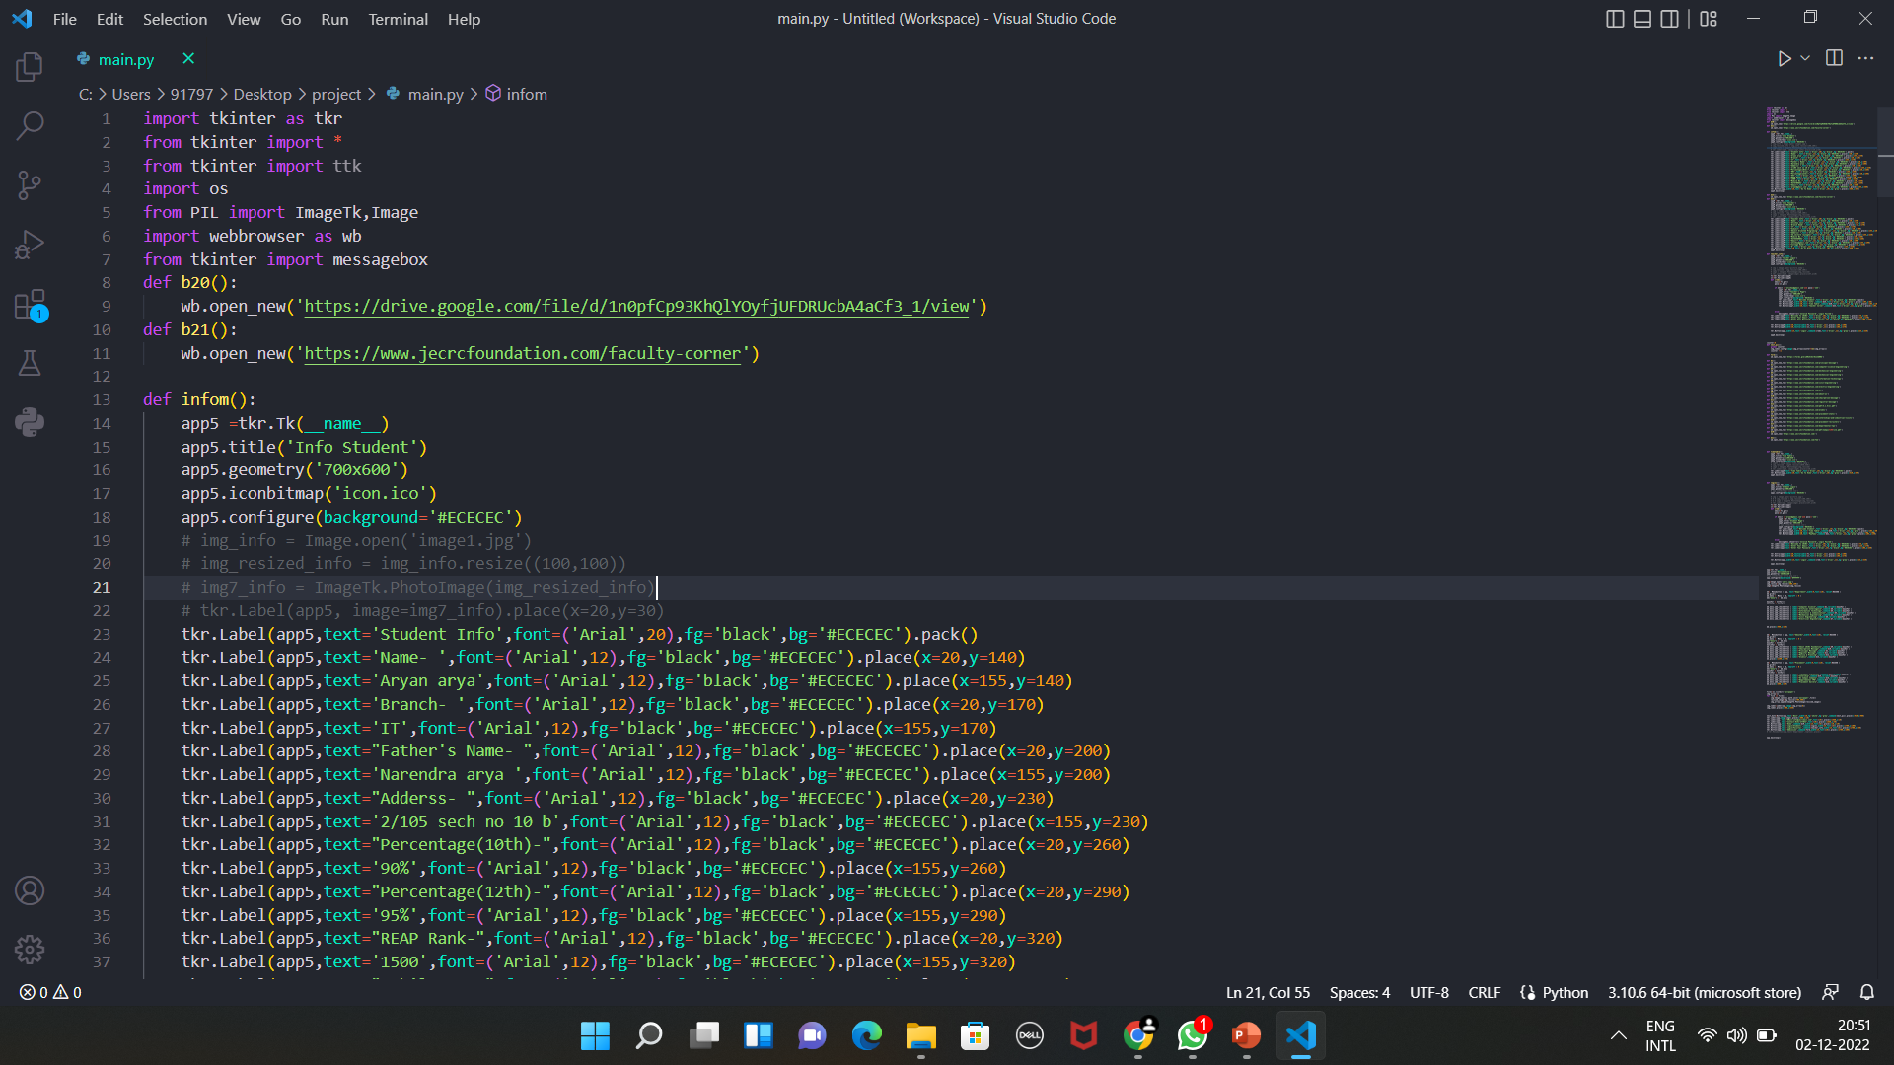
Project Code

Slide 13
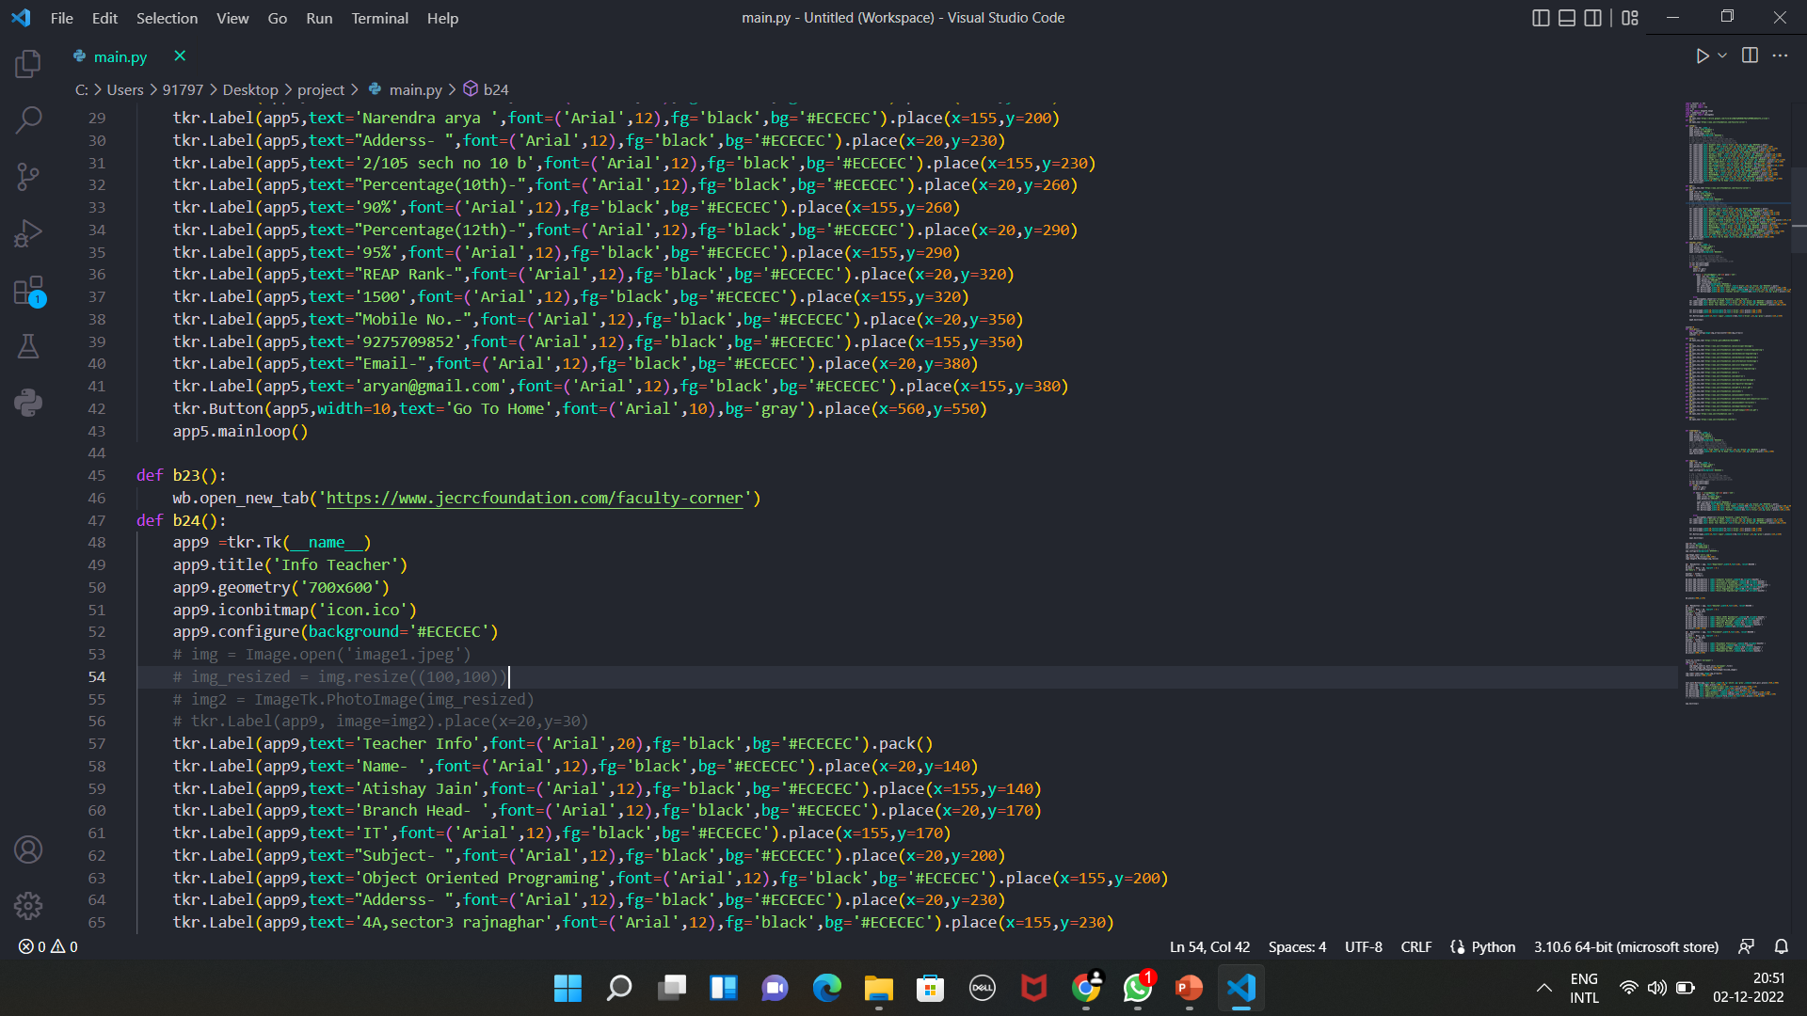

Slide 14
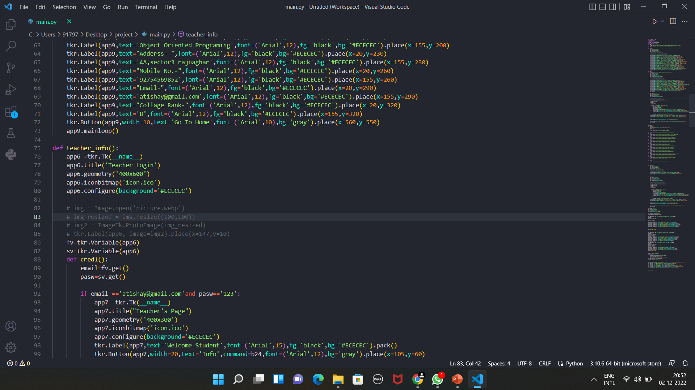

Slide 15
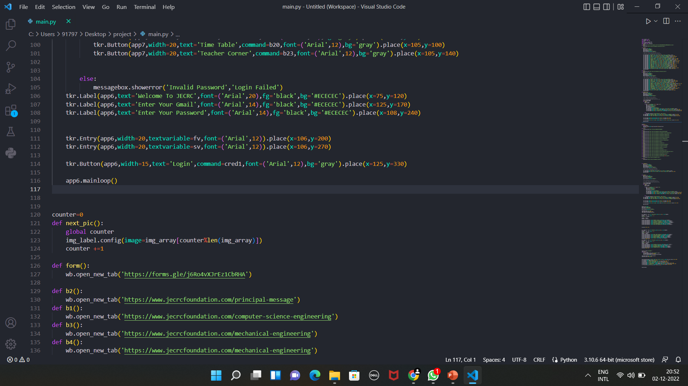

Slide 16
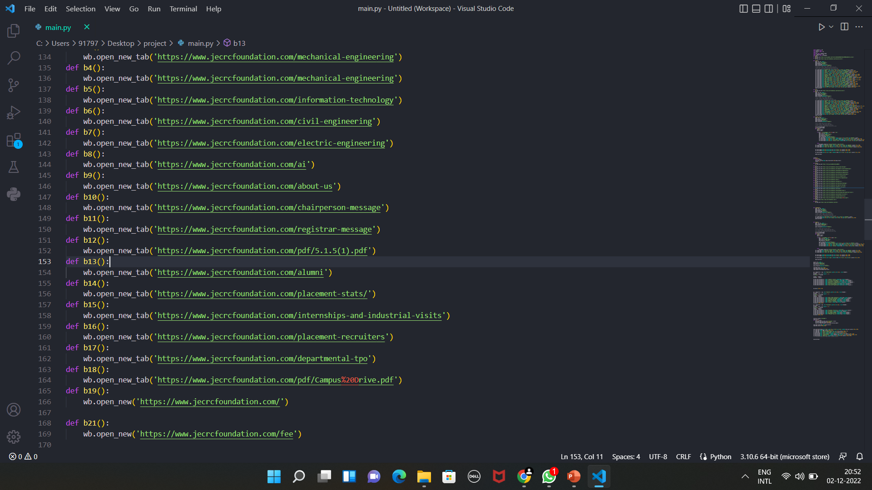

Slide 17
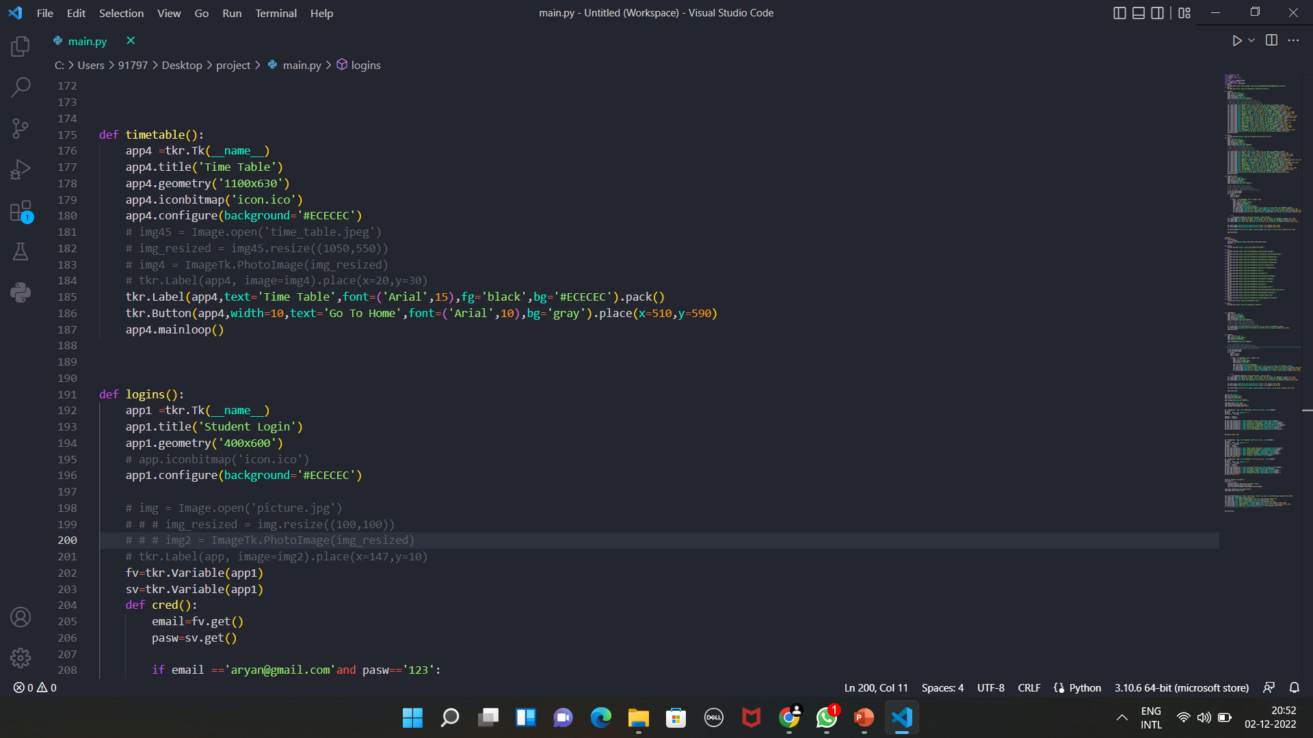

Slide 18
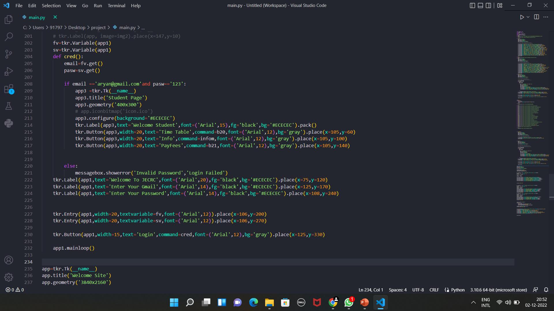

Slide 19
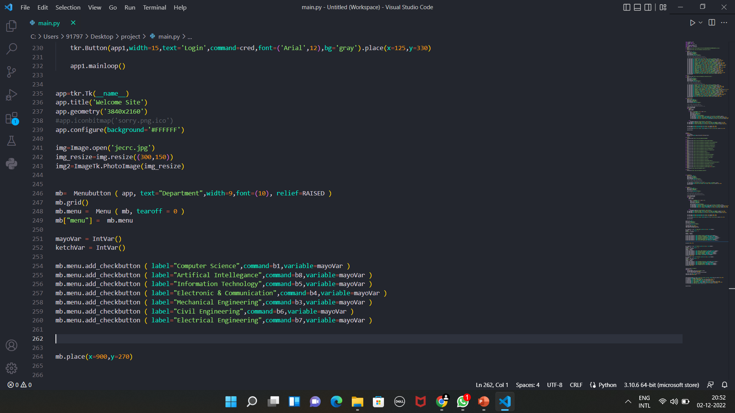

Slide 20
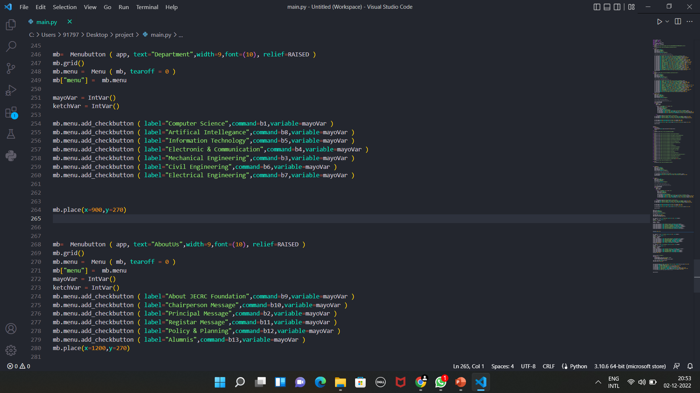

Slide 21
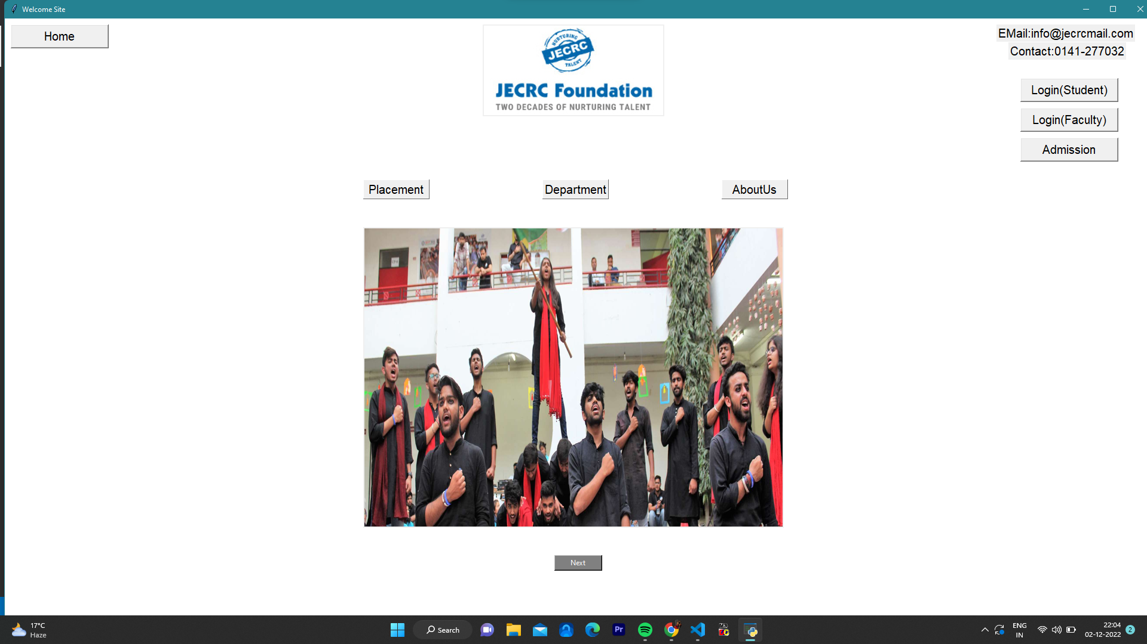
Project Glimpse

Slide 22
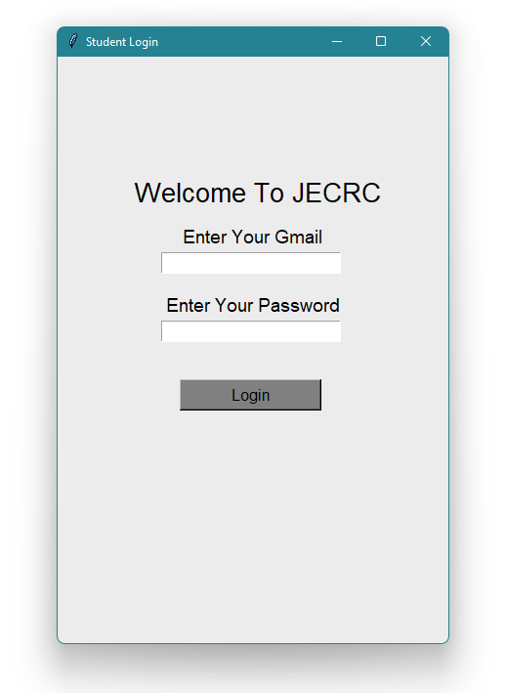

Slide 23
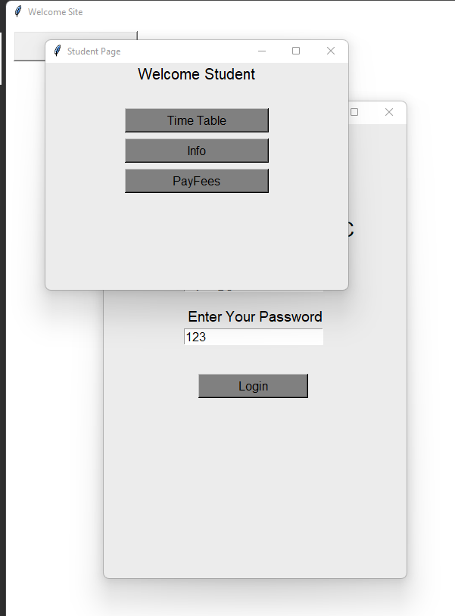

Slide 24
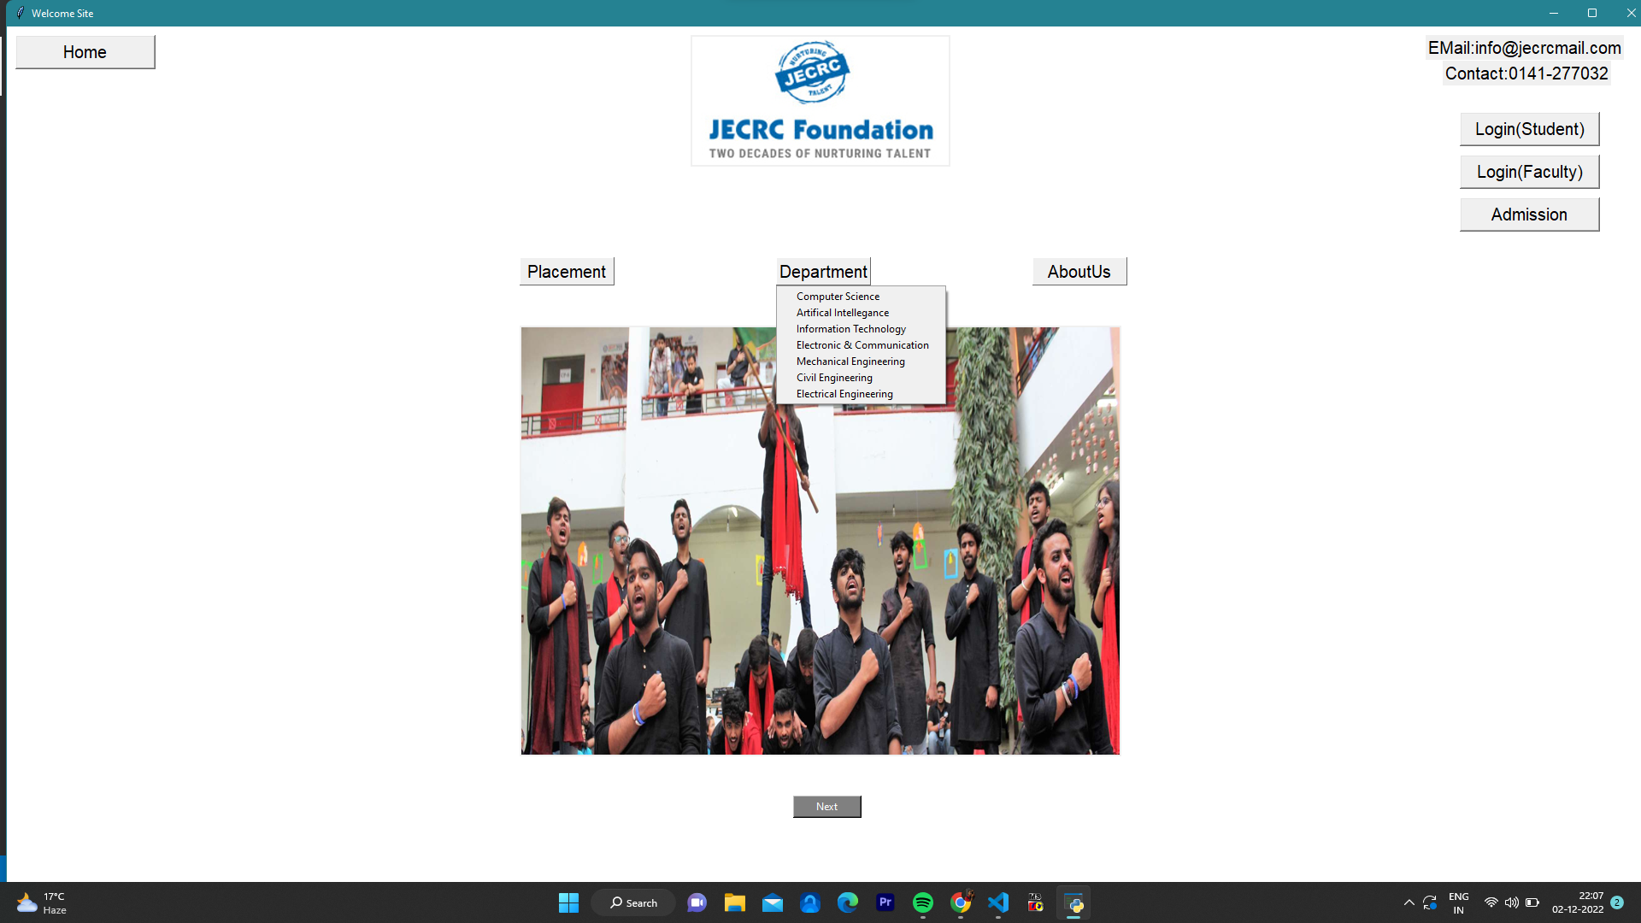

Slide 25
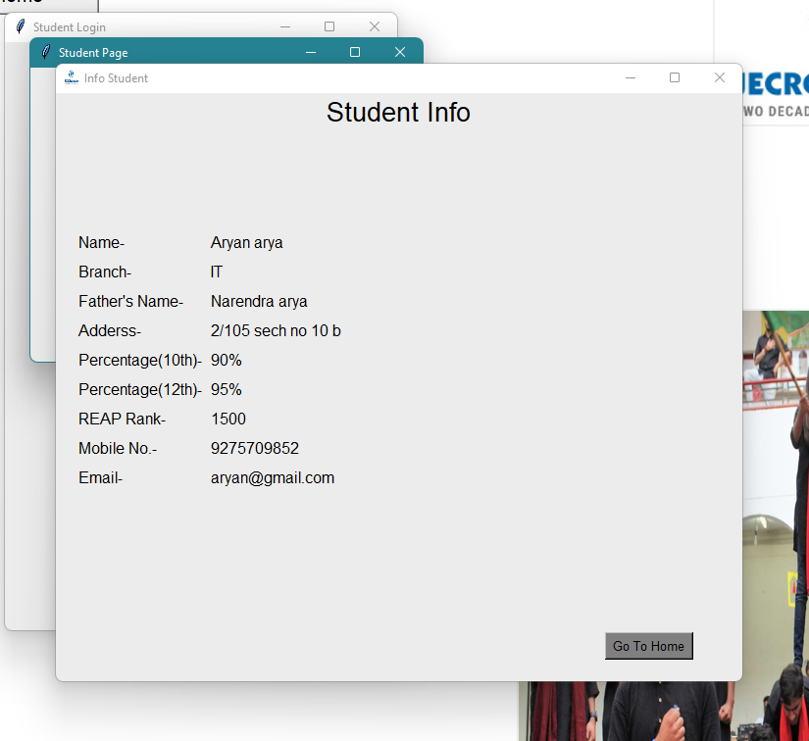

Slide 26
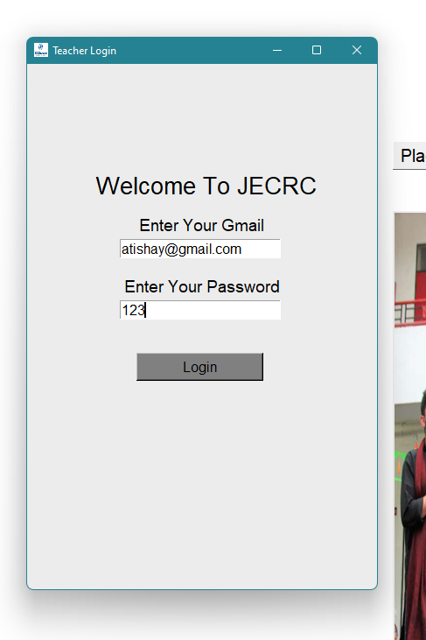

Slide 27
